Slide 1
Photography
Unit 5 – SLR Camera Usage

Slide 2
Unit 4 – Composition & Design Principles
Section 1 – Composition

Slide 3
The big idea
The bokeh effect
Aperture use
Depth of Field

Slide 4
Google Classroom Code
Photography
rhxkpt
Photography
7mdo2ur

Slide 5
Bokeh
Bokeh is defined as “the effect of a soft out-of-focus background that you get when shooting a subject, using a fast lens, at the widest aperture, such as f/2.8 or wider.”
Simply put, bokeh is the pleasing or aesthetic quality of out-of-focus blur in a photograph.

Slide 6
Knowing Depth of Field
Depth of field refers to the areas of the photograph in focus.
Small f-stop numbers produce shallow depth of field, or selective focus. This is when the background is blurry. Great for portraits.
Medium f-stop numbers produce a medium depth of field, still with selective focus, but with significantly more definition in the out-of-focus areas. Good for portraits and specific landscapes.
Large f-stop numbers produce a deep depth of field, meaning the foreground and background are in focus. Ideal for landscapes.

Slide 7
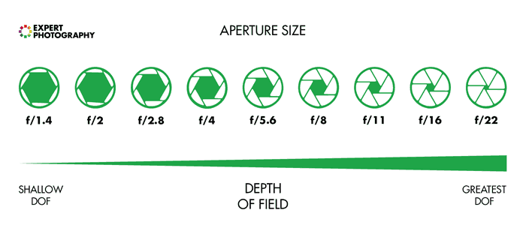
Aperture Sizes

Slide 8

Shallow Depth of Field

Slide 9

Deep Depth of Field

Slide 10

Being Creative

Slide 11
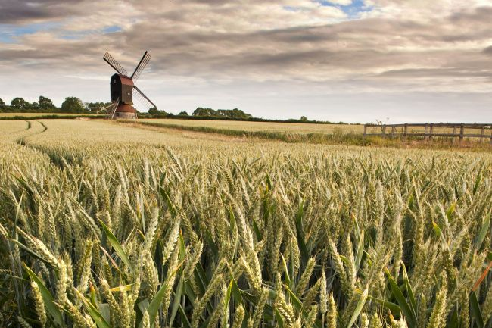
Large f-stops For Landscapes

